Slide 1

Internet of Things
“The Smartphone technology was big – the IoT is going to be a lot bigger”

Slide 2

Who coined the name IoT?..

Slide 3

What is Internet of Things ?..
Connecting any device to Internet and to other connected devices
Network of Physical objects - devices, vehicles, buildings and other items embedded with electronics, software, sensors, and network connectivity—that enables these objects to collect and exchange data

Slide 4
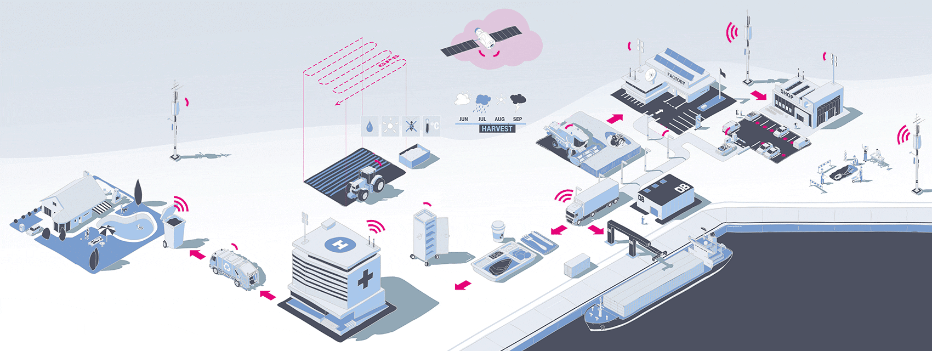
Is it limited to just connecting devices ?..
No…

Slide 5

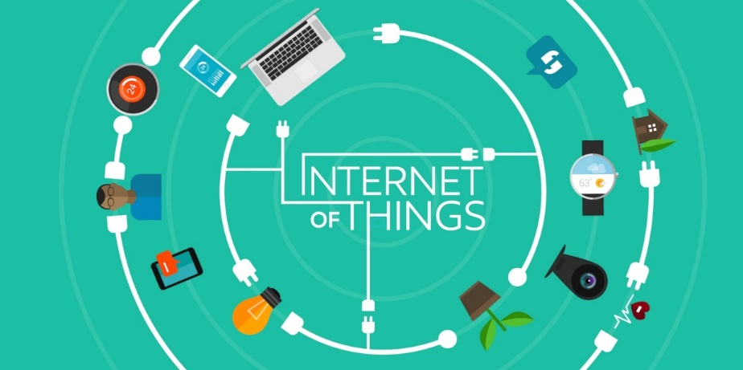
Idea: Move from Internet of People 🡪 Internet of Things
Internet appears everywhere in the world
It is primarily connection between people
Internet of Things is a plan to connect things also using the same medium

Slide 6
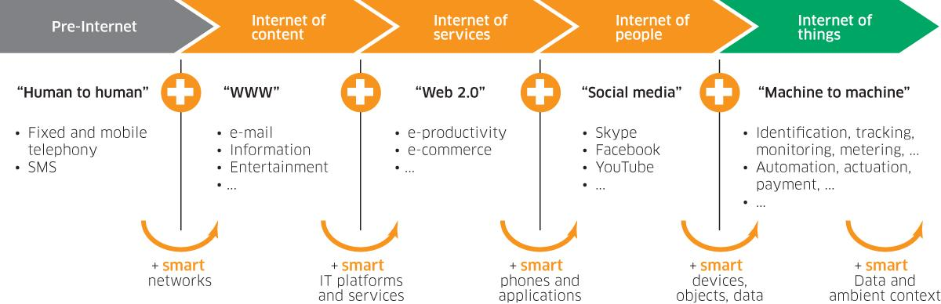
Internet of Things - Evolution

Slide 7
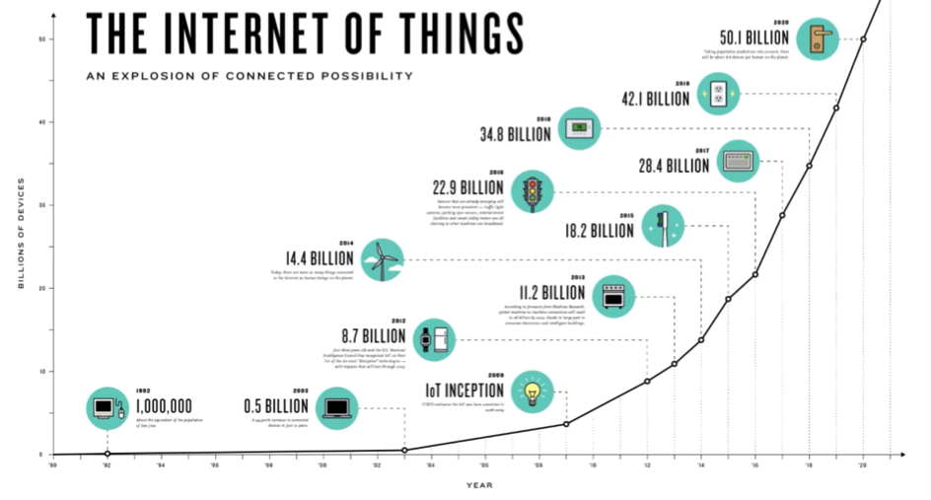
Survey…

Slide 8
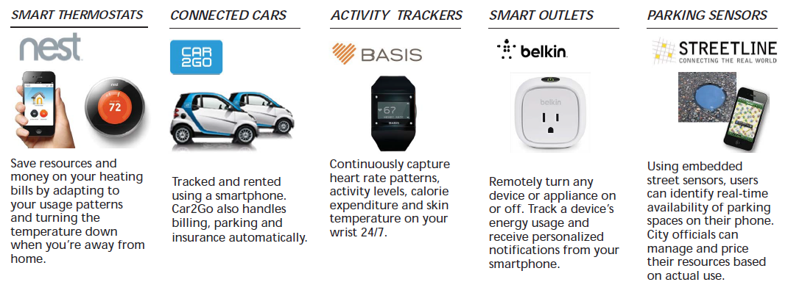
Some popular IoT devices already in the market...

Slide 9


Slide 10

These Smart things are combination of

Slide 11
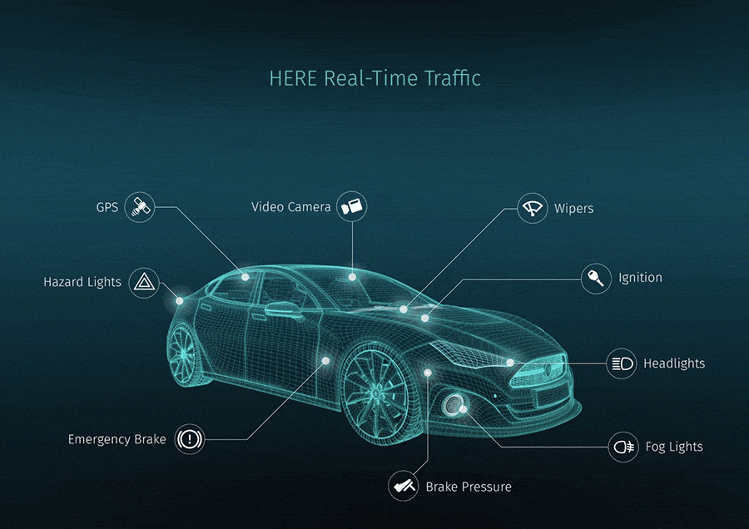
Let’s take an example…

Slide 12
IoT Technologies
Hardware (Device)
Communication Technology
Protocols for IoT
Software (IDE)
IoT Analytics
Cloud Platforms

Slide 13
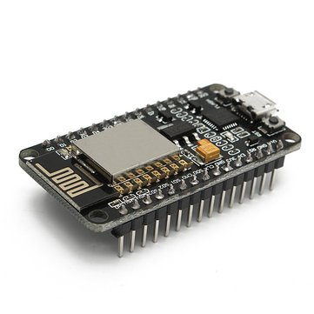
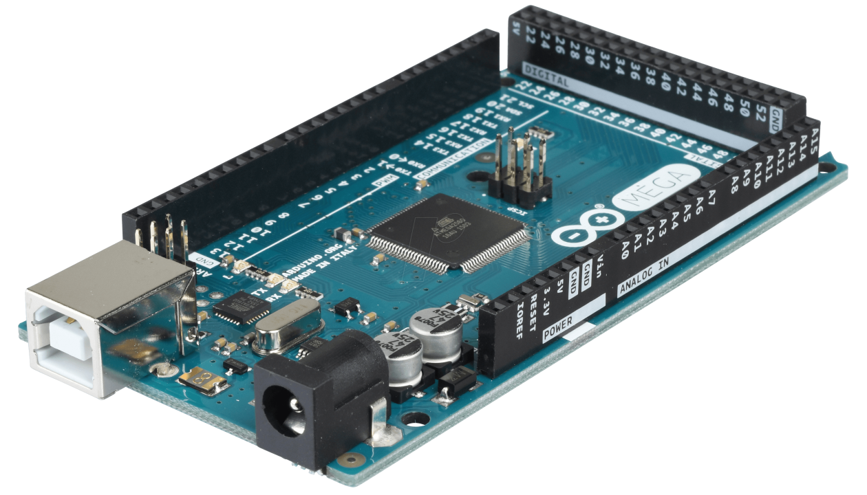
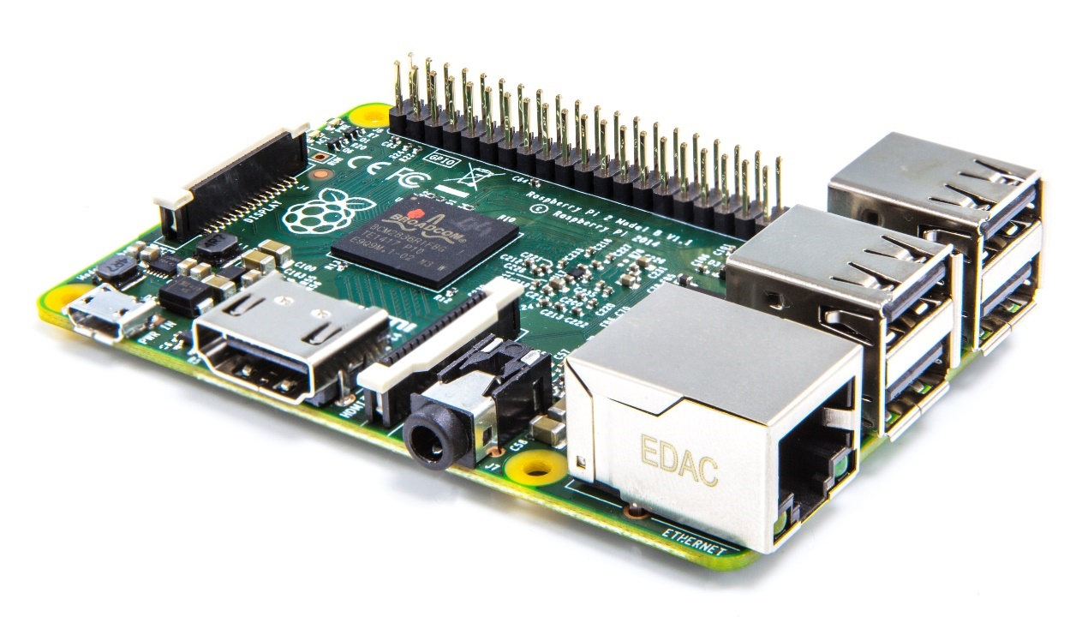
Hardwares…

Slide 14
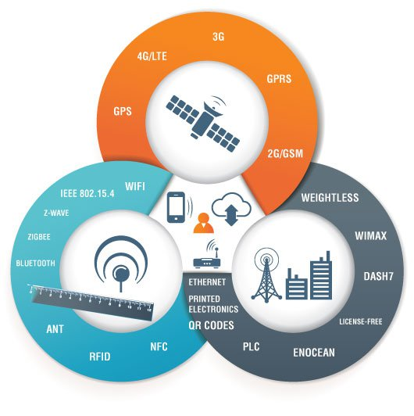
IoT Communication

Slide 15
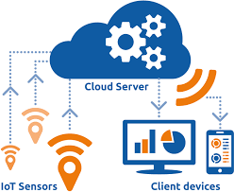
CLOUD IN IOT
The Internet of Things (IoT) involves the internet-connected devices we use to perform the processes and services that support our way of life. Another component set to help IoT succeed is cloud computing

Slide 16
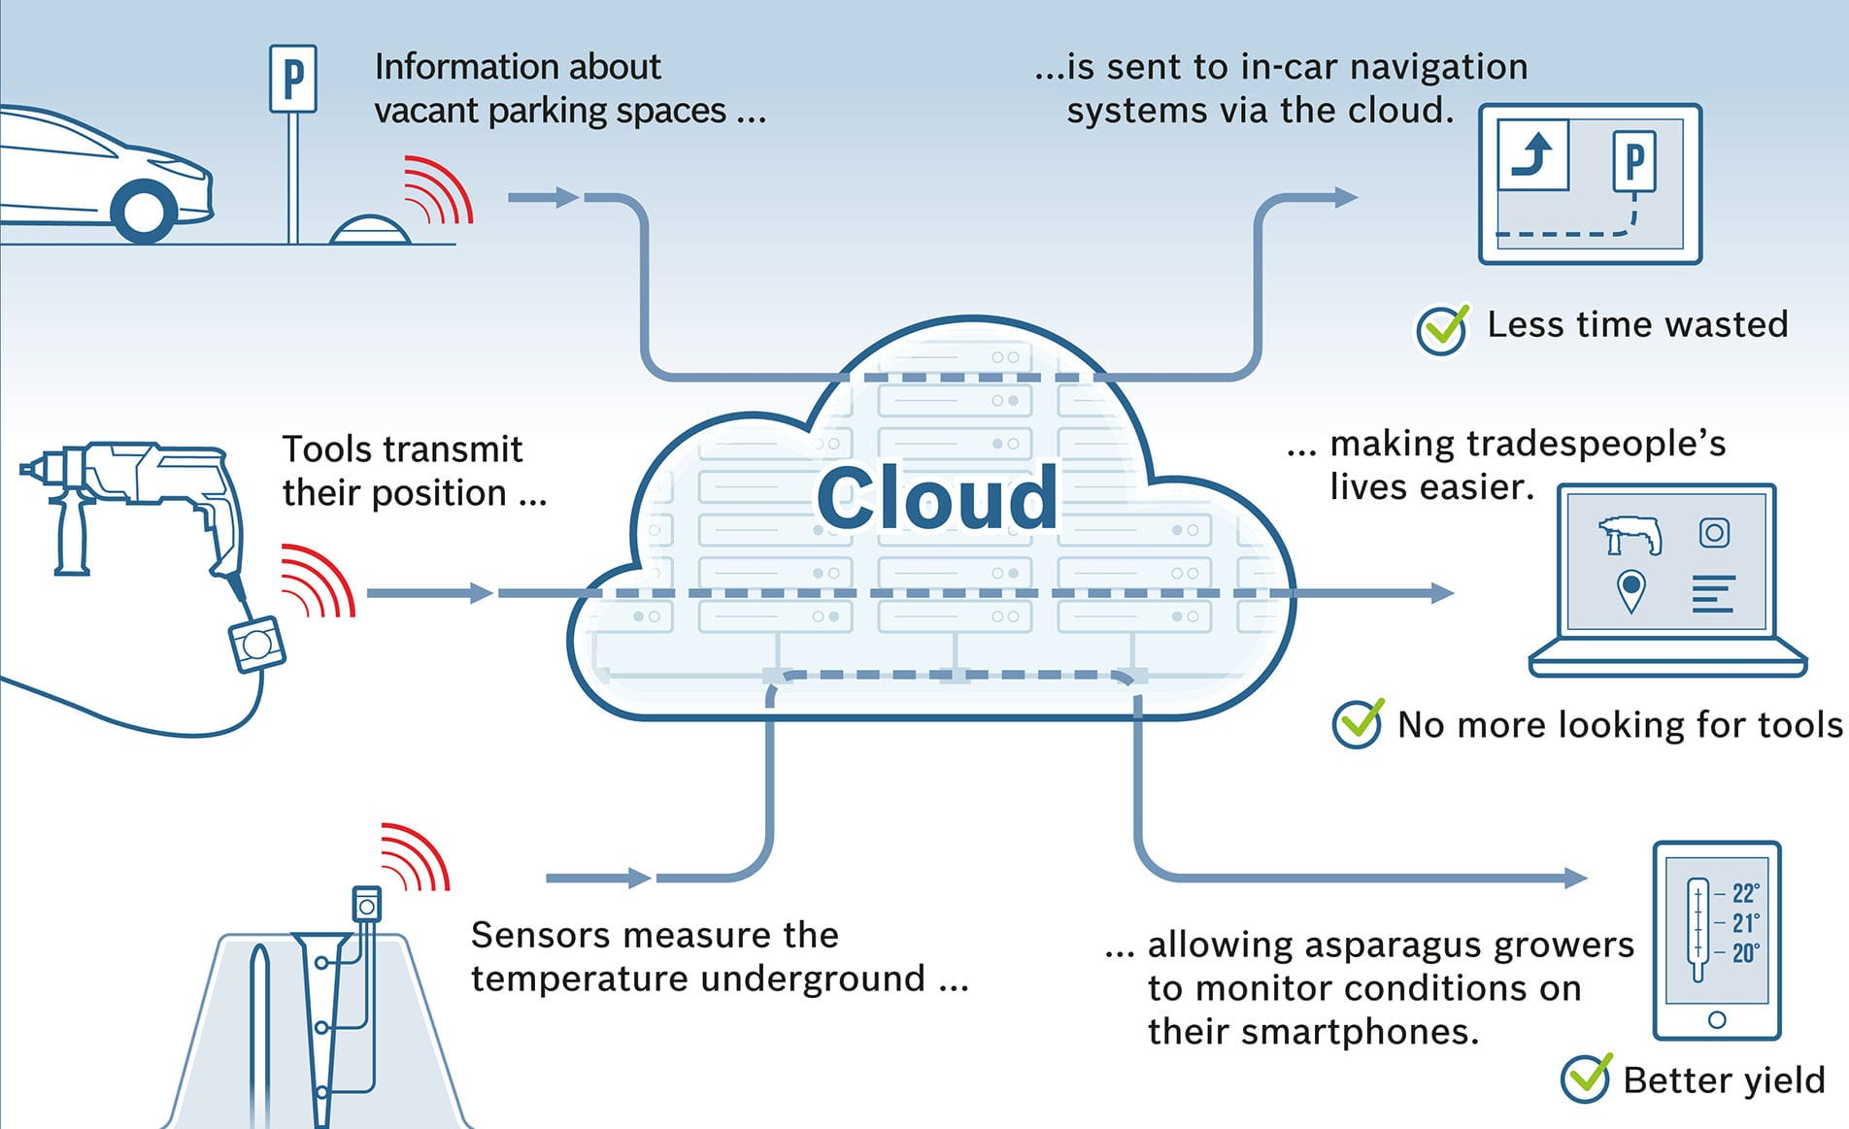
Cloud with IoT

Slide 17
FREE CLOUDS FOR IOT
1)www.thinkspeak.io
2)www.thinger.io
3)www.thingsboard.io

Slide 18
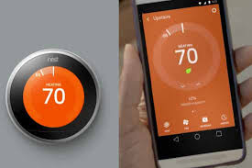
1. Nest Smart for fHome Nest thermostat
REAL TIME IOT EXAMPLES

Slide 19

REAL TIME IOT EXAMPLES
ABB: SMART ROBOTICS

Slide 20
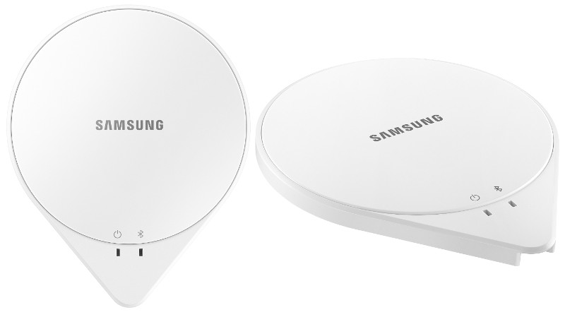
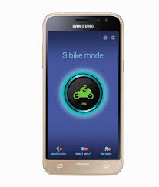
SAMSUNG SLEEP SENSE
REAL TIME IOT EXAMPLES

Slide 21

Arduino
Programing & Configuration

Slide 22
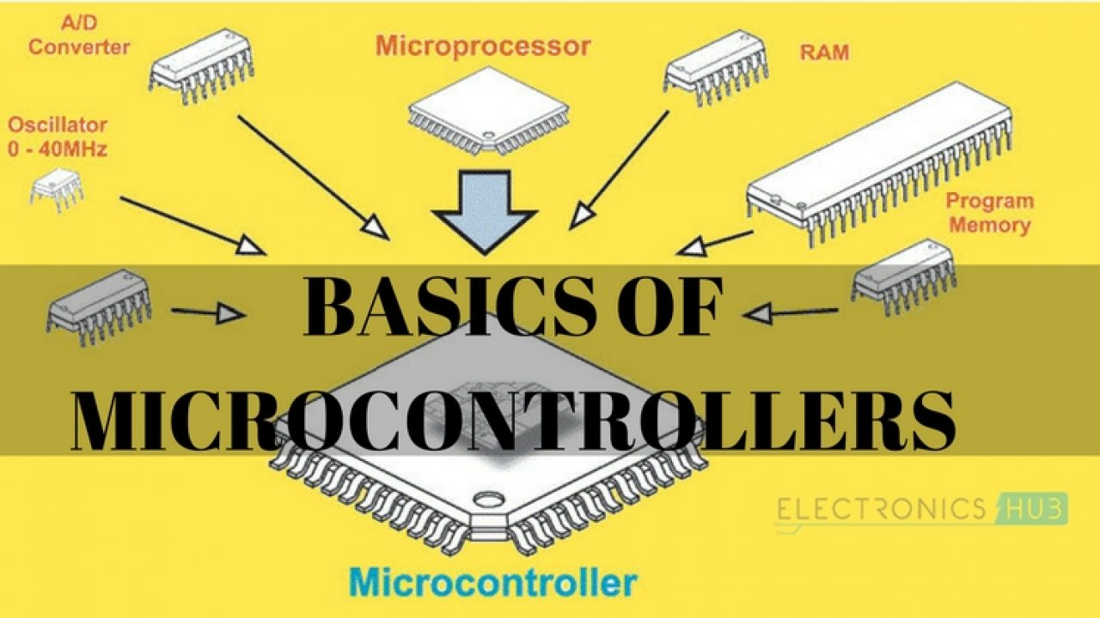

Slide 23
A microcontroller is a small and low-cost microcomputer, which is designed to perform the specific tasks of embedded systems like displaying microwave’s information, receiving remote signals, etc.
The general microcontroller consists of the processor, the memory (RAM, ROM, EPROM), Serial ports, peripherals (timers, counters), etc.
Applications of Microcontrollers
Microcontrollers are widely used in various different devices such as −
Light sensing and controlling devices like LED.
Temperature sensing and controlling devices like microwave oven, chimneys.
Fire detection and safety devices like Fire alarm.
Measuring devices like Volt Meter.

Slide 24


Slide 25
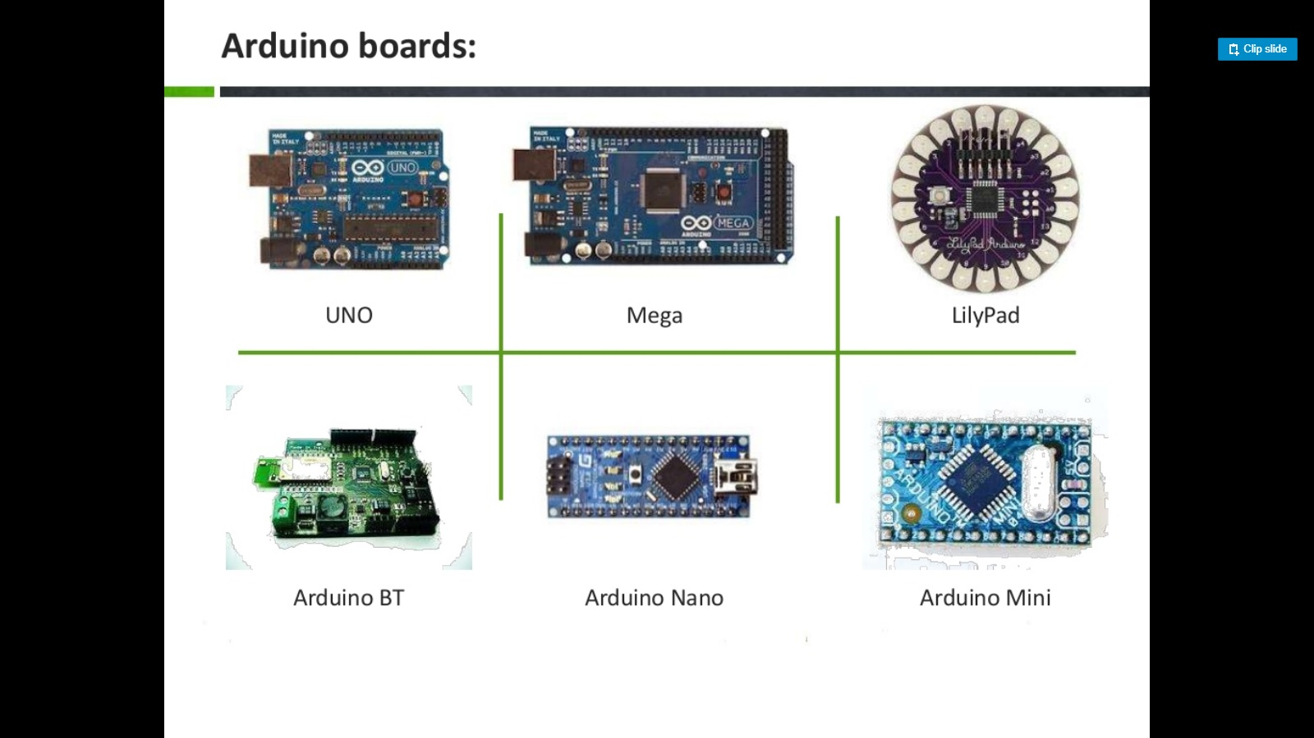

Slide 26
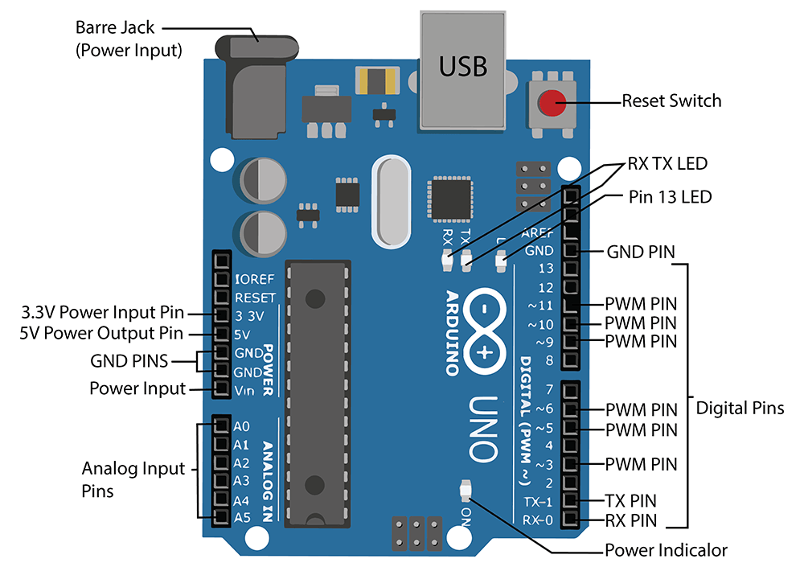
Arduino Pin Details

Slide 27
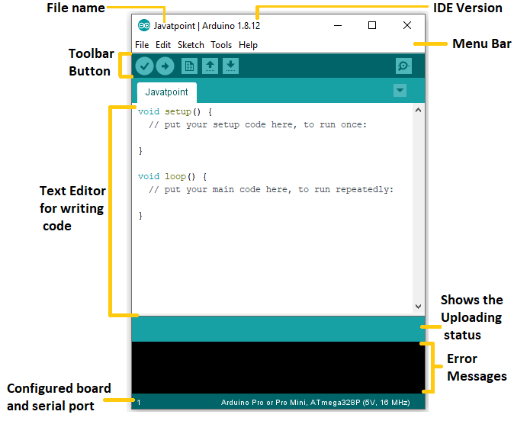
Arduino IDE

Slide 28
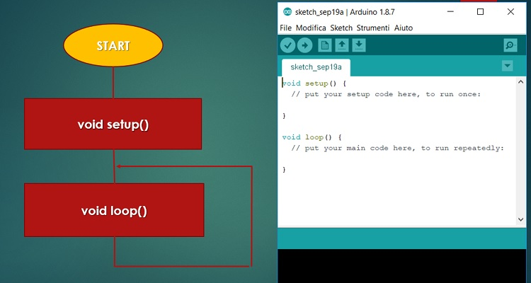
Arduino Programing Structure

Slide 29
Arduino Keywords
digitalWrite() ;
digitalRead();
pinMode();
analogRead()
analogWrite()
Delay();
Serial.begin()

Slide 30
Define pins in Arduino
#define led 4;
Const int led = 4;
Arduino Library
#include <libraryname.h>
Example : #include<dh11.h>

Slide 31
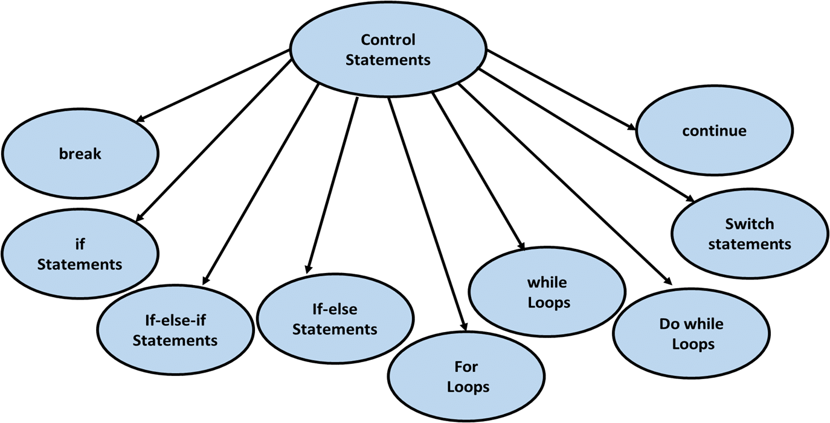
Control Statements :

Slide 32
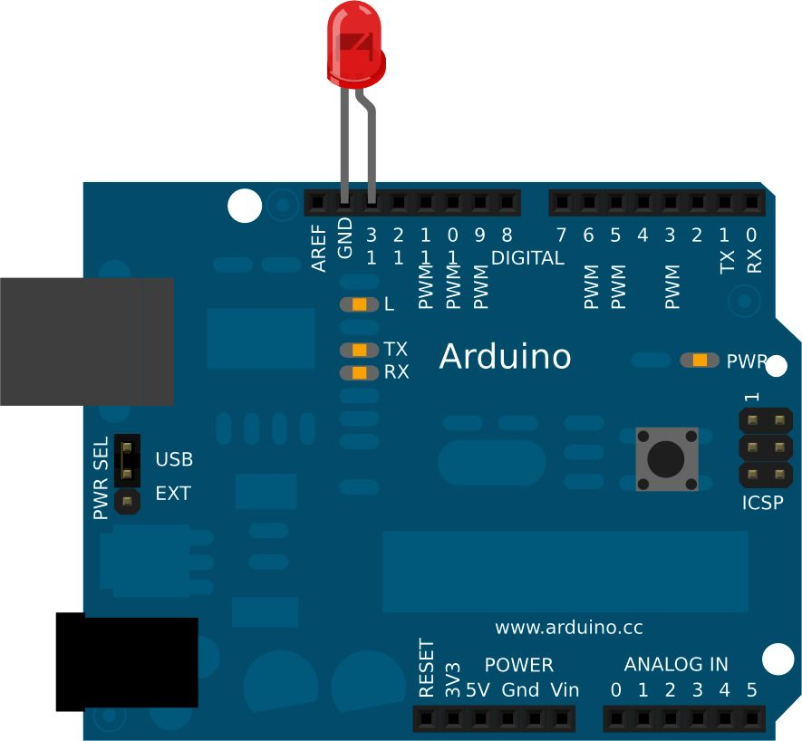
Fading Led Program
Components Required
1 × Breadboard
1 × Arduino Uno
1 × LED
2 × Jumper
Notes:
const int led = 4;
void setup()
{
pinMode(led,OUTPUT);
Serial.begin(9600);
}
void loop()
{
for(int i;i<=255;i++)
{
Serial.println(i);
analogWrite(led,1);
delay(100);
}
for(int i=255;i<=255;i--)
{
Serial.println(i);
analogWrite(led,1);
delay(100);
}}

Slide 33
Blinking Led Program
Components Required
1 × Breadboard
1 × Arduino Uno
1 × LED
2 × Jumper
Notes:
void setup()
{
// initialize digital pin 13 as an output.
pinMode(13, OUTPUT);
}
void loop() {
digitalWrite(13, HIGH);
delay(1000);
digitalWrite(13, LOW);
delay(1000);
}

Slide 34
User Define function Led Program
Components Required
1 × Breadboard
1 × Arduino Uno
1 × LED
2 × Jumper

Slide 35
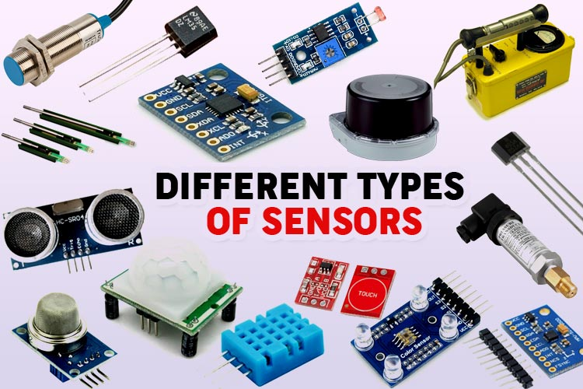

Slide 36
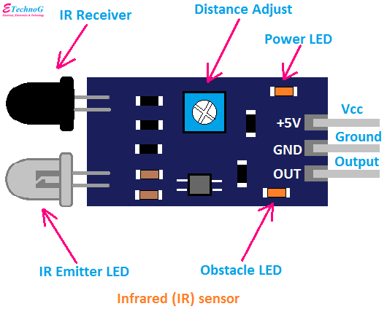

Slide 37
Serial Monitor control led
Notes:
const int relay = 13;
void setup()
{
Serial.begin(9600);
pinMode(relay,OUTPUT);
}
void loop()
{
if(Serial.available()>0)
{
delay(100);
int val = Serial.read();
if(val == 'a')
{
digitalWrite(relay,HIGH);
Serial.println("Relay ON");
}
if(val=='b')
{
digitalWrite(relay,LOW);
Serial.println("Relay OFF");
}
}
}
````````````````````````````````````````````````````````````````

Slide 38
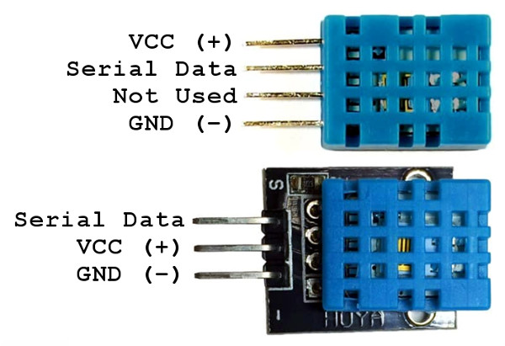
DH11

Slide 39
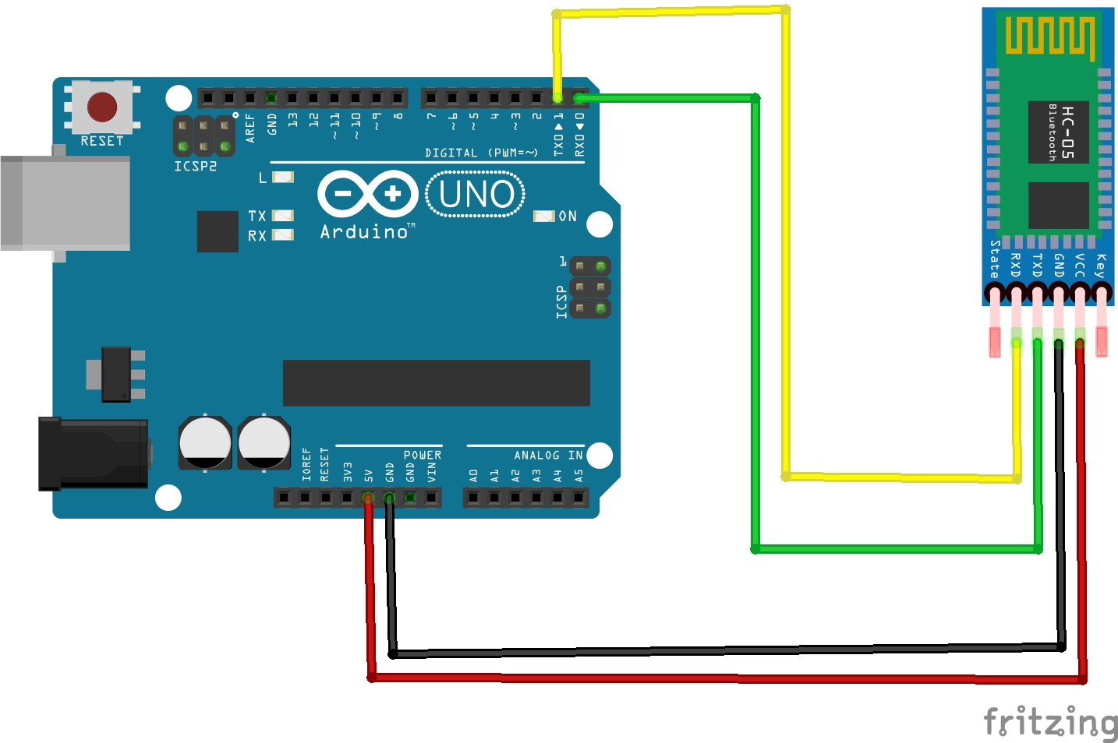
Arduino UNO interface BT module HC05
Notes:
#include "DHT.h"
#define DHTPIN 9
#define DHTTYPE DHT11 // DHT 11
//#define DHTTYPE DHT22 // DHT 22 (AM2302), AM2321
//#define DHTTYPE DHT21 // DHT 21 (AM2301)
DHT dht(DHTPIN, DHTTYPE);
void setup() {
Serial.begin(9600);
//Serial.println(F("DHTxx test!"));
dht.begin();
}
void loop() {
// Wait a few seconds between measurements.
delay(2000);
float h = dht.readHumidity();
float t = dht.readTemperature();
// Read temperature as Fahrenheit (isFahrenheit = true)
float f = dht.readTemperature(true);
// Check if any reads failed and exit early (to try again).
if (isnan(h) || isnan(t) || isnan(f)) {
Serial.println(F("Failed to read from DHT sensor!")); // is NOT A NUMBER which return true when it is not a number.
return;
}
Serial.print("Humidity: ");
Serial.println(h);
Serial.println();
Serial.print("Temperature: ");
Serial.print(t);
Serial.println("°C");
Serial.println();
Serial.print("Fahrenheit: ");
Serial.println(f);
Serial.println("\n");
}

Slide 40
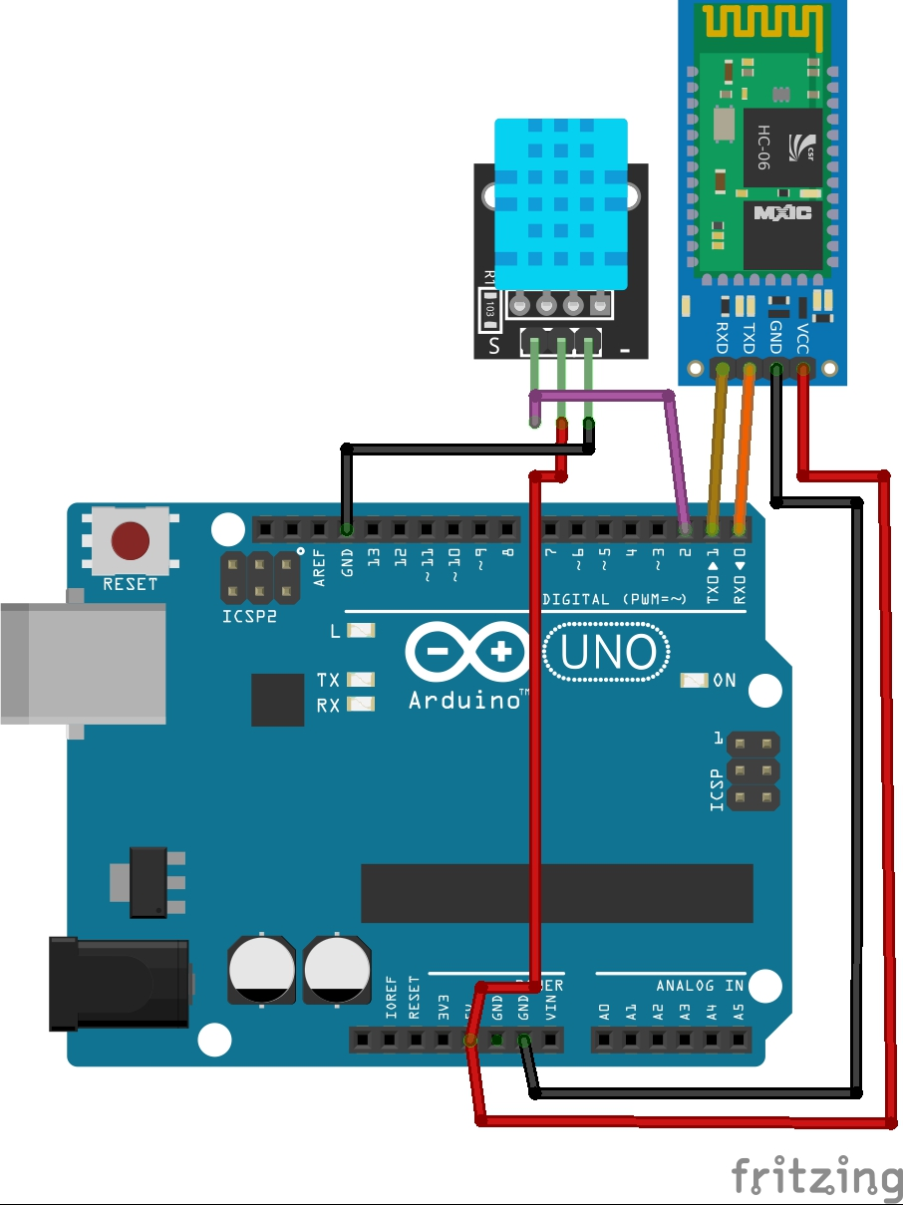

Slide 41
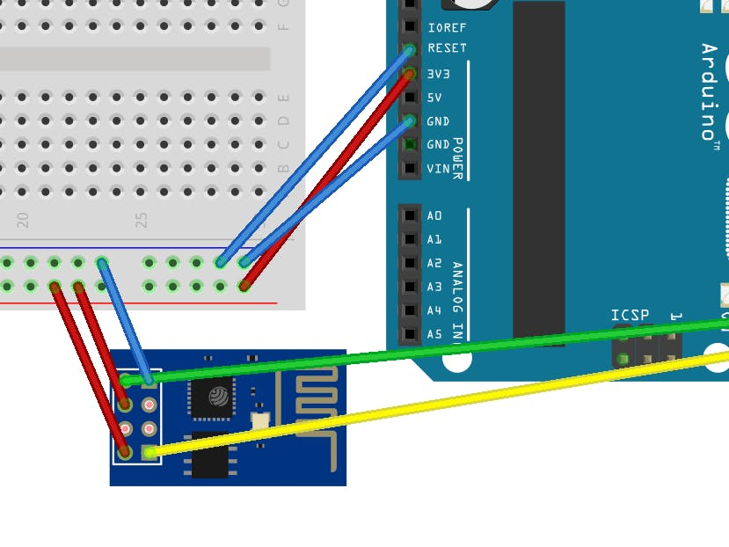
Connecting Arduino Uno with Mobile Devices (ESP8266)

Slide 42
AT COMMENTS
Device Check - AT
Show IP Address – AT+CIFSR
Show wifi name – AT+CWJAP
List Out the Networks-AT+CWLAP
Connect wifi to the module – AT+CWJAP=“SSID”,”PASSWORD”

Slide 43

Connect the ESP8266 module send the data in Google server
AT+CWMODE=1
AT+CWJAP=“SSID”,”PASSWORD”
AT+CIPSTART = “tcp”,”google.com”,”80
AT+CIPSEND = 18
>r/n
AT+CIPCLOSE

Slide 44

Notes:
//Google Assistant Home Automation using IFTTT
#include <ESP8266WiFi.h>
#include "Adafruit_MQTT.h"
#include "Adafruit_MQTT_Client.h"
#define Relay1 D1
#define Relay2 D2
#define Relay3 D3
#define Relay4 D4
#define WLAN_SSID "spv" // Your SSID
#define WLAN_PASS "987654321" // Your password
/************************* Adafruit.io Setup *********************************/
#define AIO_SERVER "io.adafruit.com" //Adafruit Server
#define AIO_SERVERPORT 1883
#define AIO_USERNAME "vickyeee" // Username
#define AIO_KEY "aio_jarp10KikhpuI29bShmpdHpBZ8Gh" // Auth Key
//WIFI CLIENT
WiFiClient client;
Adafruit_MQTT_Client mqtt(&client,AIO_SERVER, AIO_SERVERPORT, AIO_USERNAME, AIO_KEY);
Adafruit_MQTT_Subscribe led1 = Adafruit_MQTT_Subscribe(&mqtt, AIO_USERNAME"/feeds/led1"); // Feeds name should be same everywhere
Adafruit_MQTT_Subscribe led2 = Adafruit_MQTT_Subscribe(&mqtt, AIO_USERNAME "/feeds/led2");
Adafruit_MQTT_Subscribe Light3 = Adafruit_MQTT_Subscribe(&mqtt, AIO_USERNAME "/feeds/Relay3");
Adafruit_MQTT_Subscribe Light4 = Adafruit_MQTT_Subscribe(&mqtt, AIO_USERNAME "/feeds/Relay4");
void MQTT_connect();
void setup() {
Serial.begin(115200);
pinMode(Relay1, OUTPUT);
pinMode(Relay2, OUTPUT);
pinMode(Relay3, OUTPUT);
pinMode(Relay4, OUTPUT);
// Connect to WiFi access point.
Serial.println(); Serial.println();
Serial.print("Connecting to ");
Serial.println(WLAN_SSID);
WiFi.begin(WLAN_SSID, WLAN_PASS);
while (WiFi.status() != WL_CONNECTED) {
delay(500);
Serial.print(".");
}
Serial.println();
Serial.println("WiFi connected");
Serial.println("IP address: ");
Serial.println(WiFi.localIP());
mqtt.subscribe(&led1);
mqtt.subscribe(&Light3);
mqtt.subscribe(&led2);
mqtt.subscribe(&Light4);
}
void loop() {
MQTT_connect();
Adafruit_MQTT_Subscribe *subscription;
while ((subscription = mqtt.readSubscription(20000))) {
if (subscription == &led1) {
Serial.print(F("Got: "));
Serial.println((char *)led1.lastread);
int led1_State = atoi((char *)led1.lastread);
digitalWrite(Relay1, led1_State);
}
if (subscription == &led2) {
Serial.print(F("Got: "));
Serial.println((char *)led2.lastread);
int led2_State = atoi((char *)led2.lastread);
digitalWrite(Relay2, led2_State);
}
if (subscription == &Light3) {
Serial.print(F("Got: "));
Serial.println((char *)Light3.lastread);
int Light3_State = atoi((char *)Light3.lastread);
digitalWrite(Relay3, Light3_State);
}
if (subscription == &Light4) {
Serial.print(F("Got: "));
Serial.println((char *)Light4.lastread);
int Light4_State = atoi((char *)Light4.lastread);
digitalWrite(Relay4, Light4_State);
}
}
}
void MQTT_connect() {
int8_t ret;
if (mqtt.connected()) {
return;
}
Serial.print("Connecting to MQTT... ");
uint8_t retries = 3;
while ((ret = mqtt.connect()) != 0) {
Serial.println(mqtt.connectErrorString(ret));
Serial.println("Retrying MQTT connection in 5 seconds...");
mqtt.disconnect();
delay(5000);
retries--;
if (retries == 0) {
while (1);
}
}
Serial.println("MQTT Connected!");
}

Slide 45
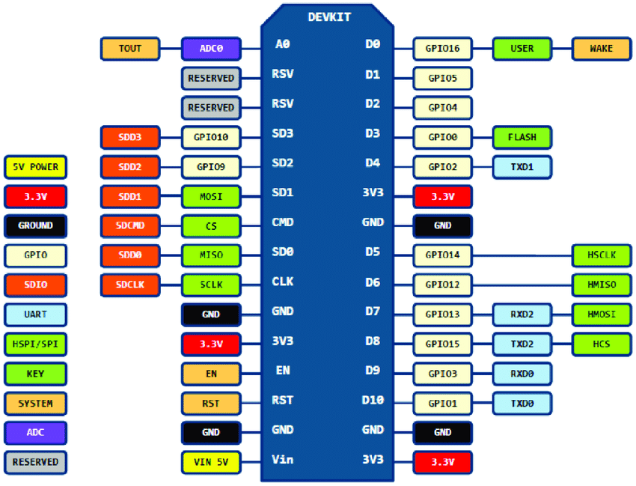

Slide 46
Program
void setup() {
// put your setup code here, to run once:
Serial.begin(115200);
Serial.println("Hello, ESP32!");
}
void loop() {
// put your main code here, to run repeatedly:
delay(10); // this speeds up the simulation
}

Slide 47
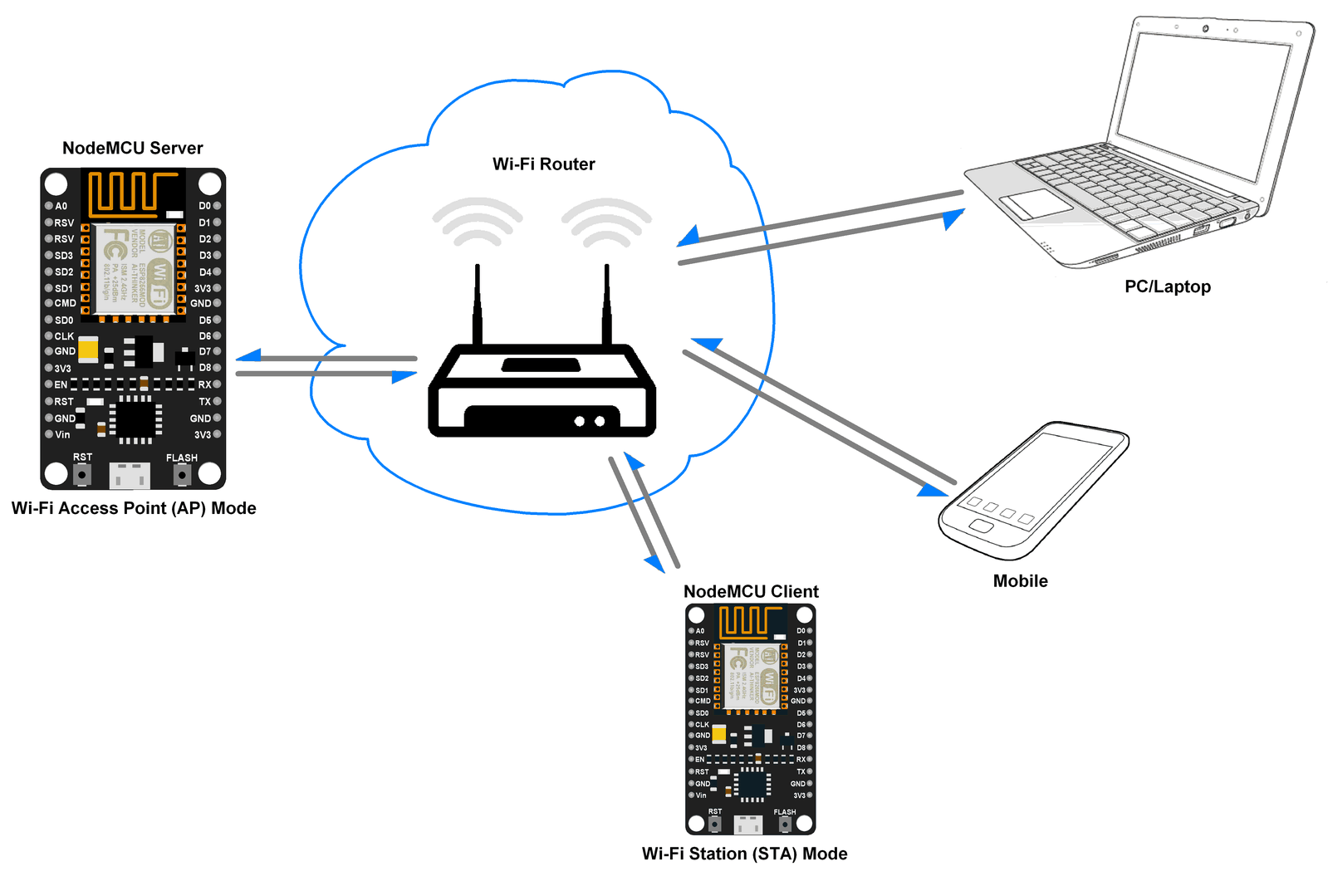
nodeMCU working as a server
Notes:
https://github.com/wokwi/wokwigw/releases/tag/v0.1.2

Slide 48
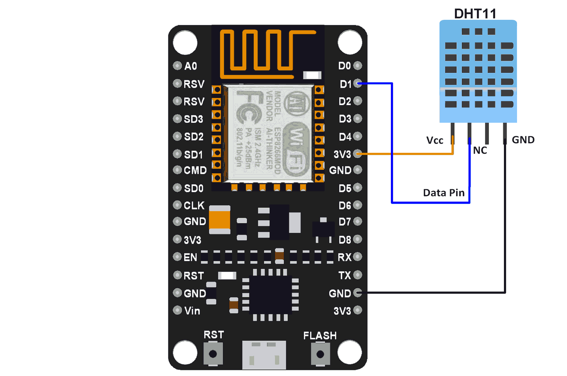
nodeMCU DH11 interface

Slide 49
